Slide 1
Continuous Target Shift Adaptation using Supervised Learning
Aditya Saripalli
Lokesh Balani
Naveen Kumar Pandey
Aravind M

Slide 2
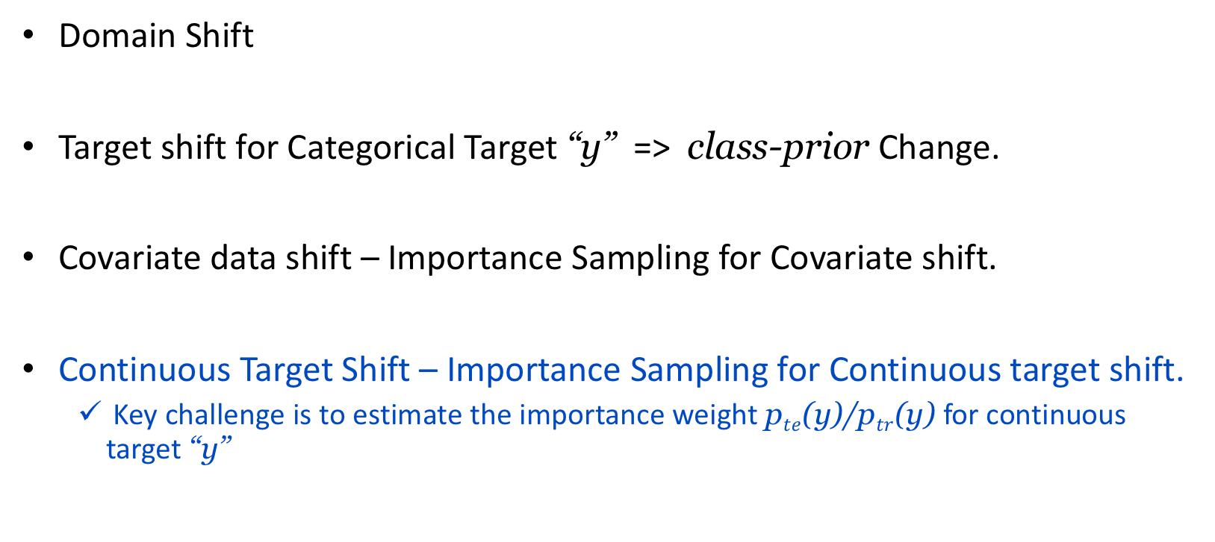
Different Data Shifts . . .
Domain Shift
Target shift for Categorical Target “y” => class-prior Change.
Covariate data shift – Importance Sampling for Covariate shift.
Continuous Target Shift – Importance Sampling for Continuous target shift.
Key challenge is to estimate the importance weight p$te$(y)/p$tr$(y) for continuous target “y”

Slide 3
Everything in few words . . .
Traditional Assumption:
Training and test data follow the same distribution.
In Reality:
The assumption is often violated due to intrinsic non-stationary environment or inevitable sample bias - “Data Shift / Target Shift”.
Problem Description:
Supervised learning problem under Target Shift scenario, where the target marginal distribution p(y) changes between training and testing phases – keeping the target-conditioned covariate distribution p(x|y) unchanged.
Importance Weight Estimations for Continuous Targets – L2IWE

Slide 4
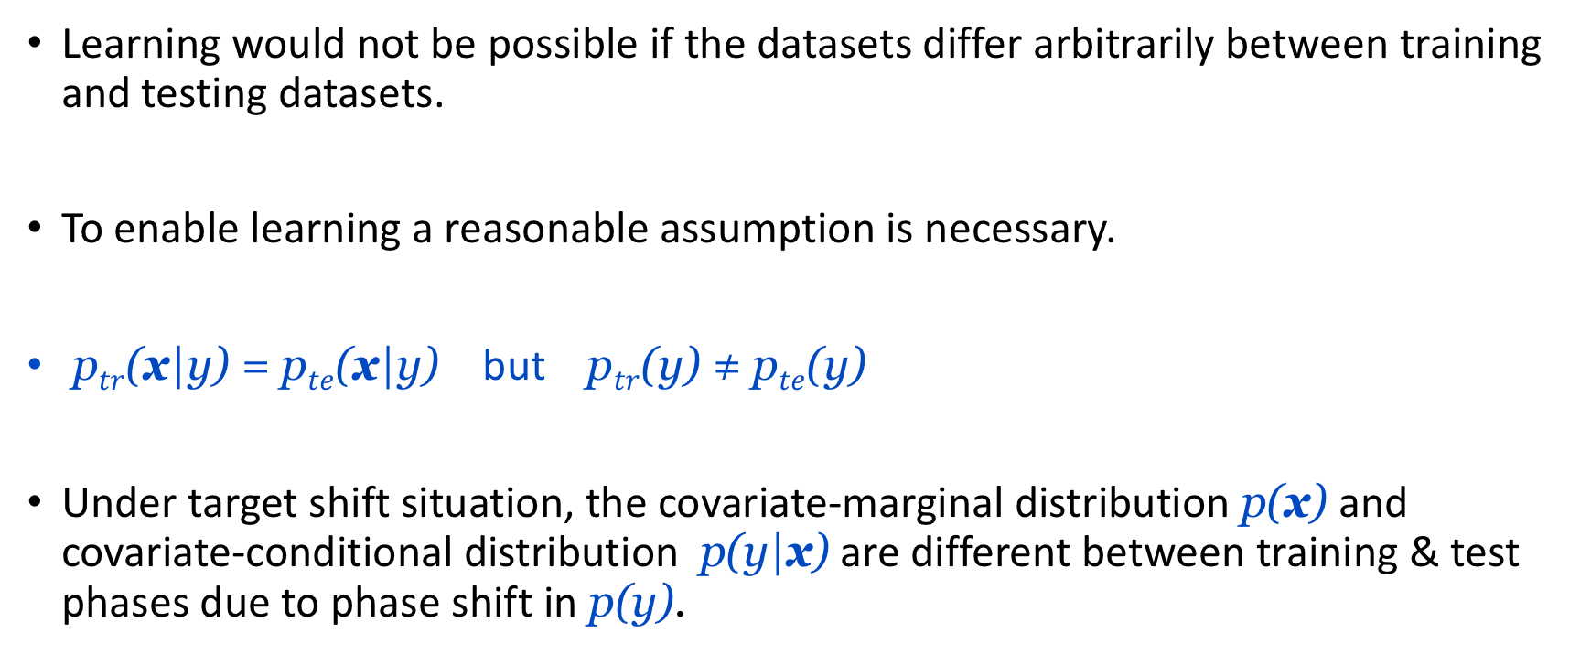
Reasonable Assumptions . . .
Learning would not be possible if the datasets differ arbitrarily between training and testing datasets.
To enable learning a reasonable assumption is necessary.
p$tr$(x|y) = p$te$(x|y) but p$tr$(y) ≠ p$te$(y)
Under target shift situation, the covariate-marginal distribution p(x) and covariate-conditional distribution p(y|x) are different between training & test phases due to phase shift in p(y).

Slide 5
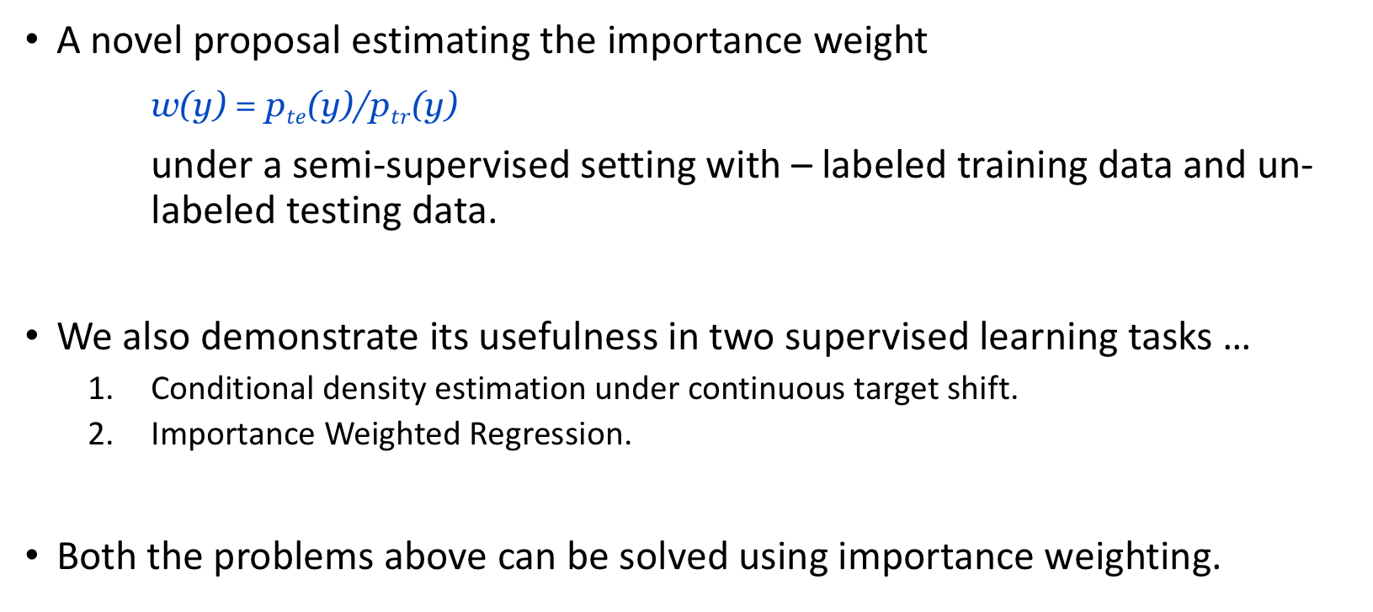
What’s New in here . . .
A novel proposal estimating the importance weight
w(y) = p$te$(y)/p$tr$(y)
under a semi-supervised setting with – labeled training data and un- labeled testing data.
We also demonstrate its usefulness in two supervised learning tasks …
Conditional density estimation under continuous target shift.
Importance Weighted Regression.
Both the problems above can be solved using importance weighting.

Slide 6
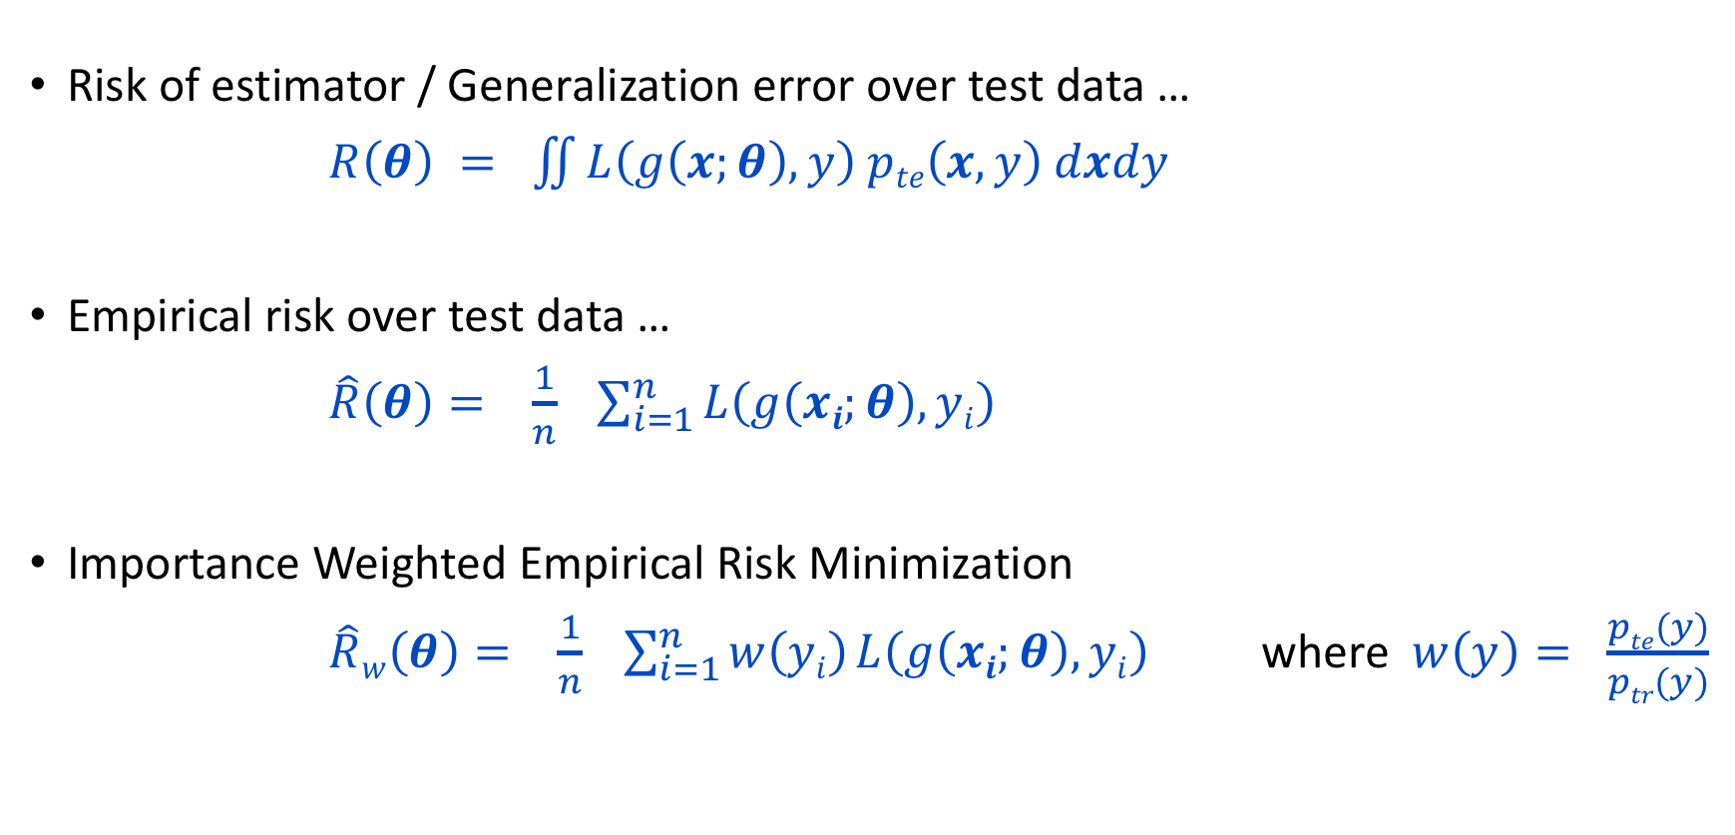
Empirical Risk Minimization . . .
Risk of estimator / Generalization error over test data …
$R\left(θ\right) = \iint{L\left(g\left(x;θ\right),y\right) pte\left(x,y\right) dxdy}$
Empirical risk over test data …
$\hat{R}\left(θ\right)= \frac{1}{n} \sum_{i=1}^{n}{L\left(g\left(xi;θ\right),yi\right)}$
Importance Weighted Empirical Risk Minimization
$\hat{R}w\left(θ\right)= \frac{1}{n} \sum_{i=1}^{n}{w\left(yi\right) L\left(g\left(xi;θ\right),yi\right)}$ where $w\left(y\right)= \frac{pte(y)}{ptr(y)}$

Slide 7
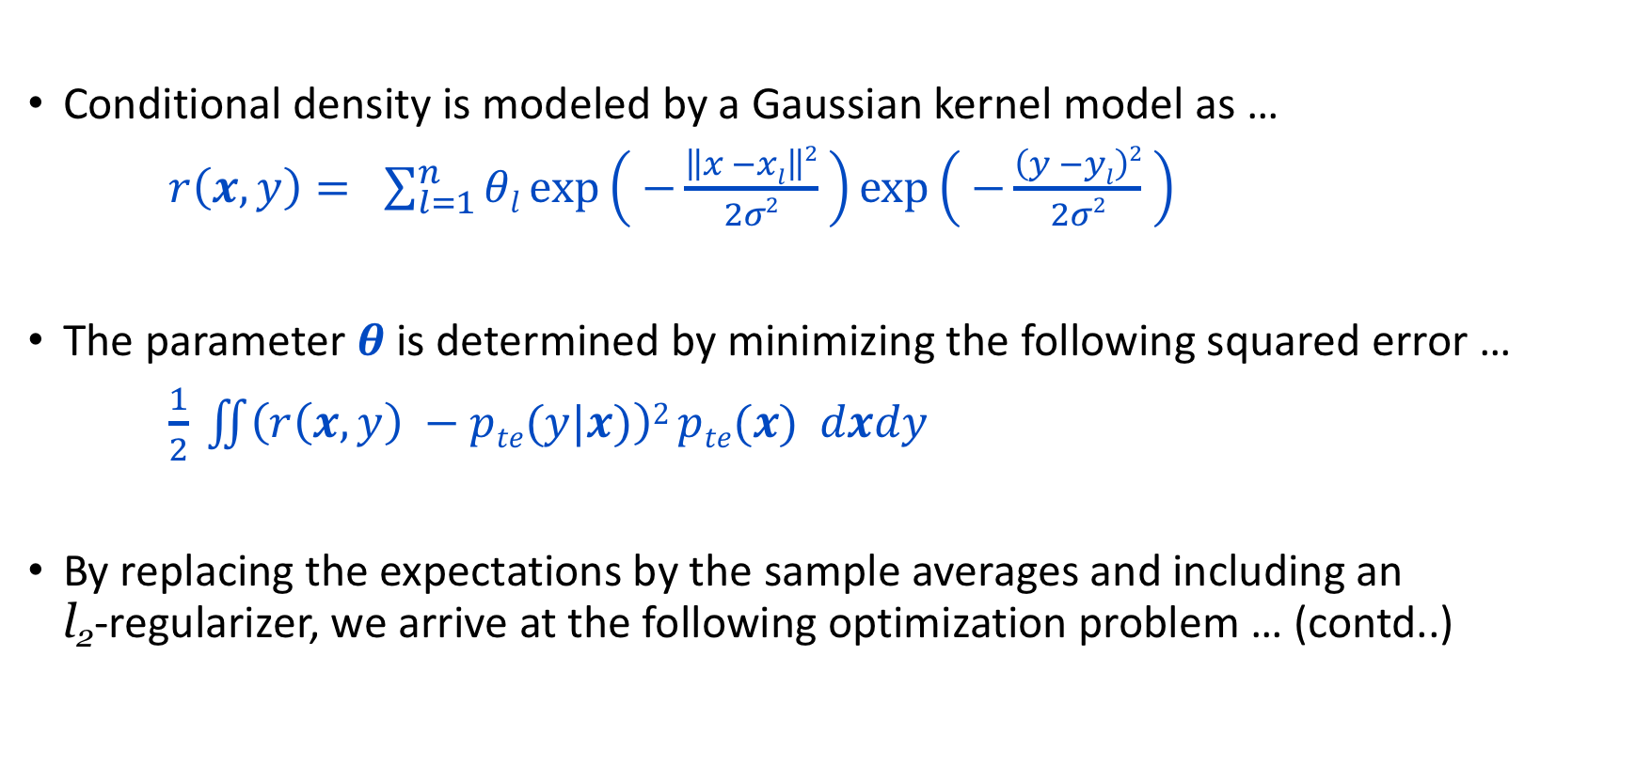
Importance Weight CDE
Conditional density is modeled by a Gaussian kernel model as …
$r\left(x, y\right)= \sum_{l=1}^{n}{θl}\exp\left( −\frac{\left\|x −xl\right\|2}{2σ2} \right)exp\left( −\frac{\left(y −yl\right)2}{2σ2} \right)$
The parameter $θ$ is determined by minimizing the following squared error …
$\frac{1}{2} \iint{\left(r\left(x,y\right) −pte(y|x)\right)2}pte(x) dxdy$
By replacing the expectations by the sample averages and including an l₂-regularizer, we arrive at the following optimization problem … (contd..)

Slide 8
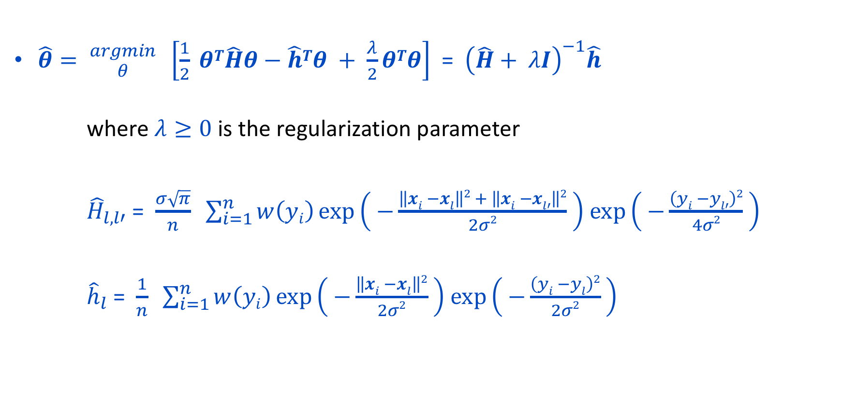
Importance Weight CDE (contd..)
$\hat{θ}= {argmin \atop θ} \left[\frac{1}{2} θT\hat{H}θ−\hat{h}Tθ + \frac{λ}{2}θTθ\right]$ = ${\left(\hat{H}+ λI\right)}^{−1}\hat{h}$
where $λ≥0$ is the regularization parameter
${\hat{H}}_{l,l′}$ = $\frac{σ\sqrt{π}}{n} \sum_{i=1}^{n}{w\left(yi\right)\exp\left( −\frac{\left\|xi −xl\right\|2 + \left\|xi −xl′\right\|2}{2σ2} \right)}$ $\exp\left( −\frac{\left(yi −yl′\right)2}{4σ2} \right)$
${\hat{h}}_{l}$ = $\frac{1}{n} \sum_{i=1}^{n}{w\left(yi\right)\exp\left( −\frac{\left\|xi −xl\right\|2}{2σ2} \right)}$ $\exp\left( −\frac{\left(yi −yl\right)2}{2σ2} \right)$

Slide 9
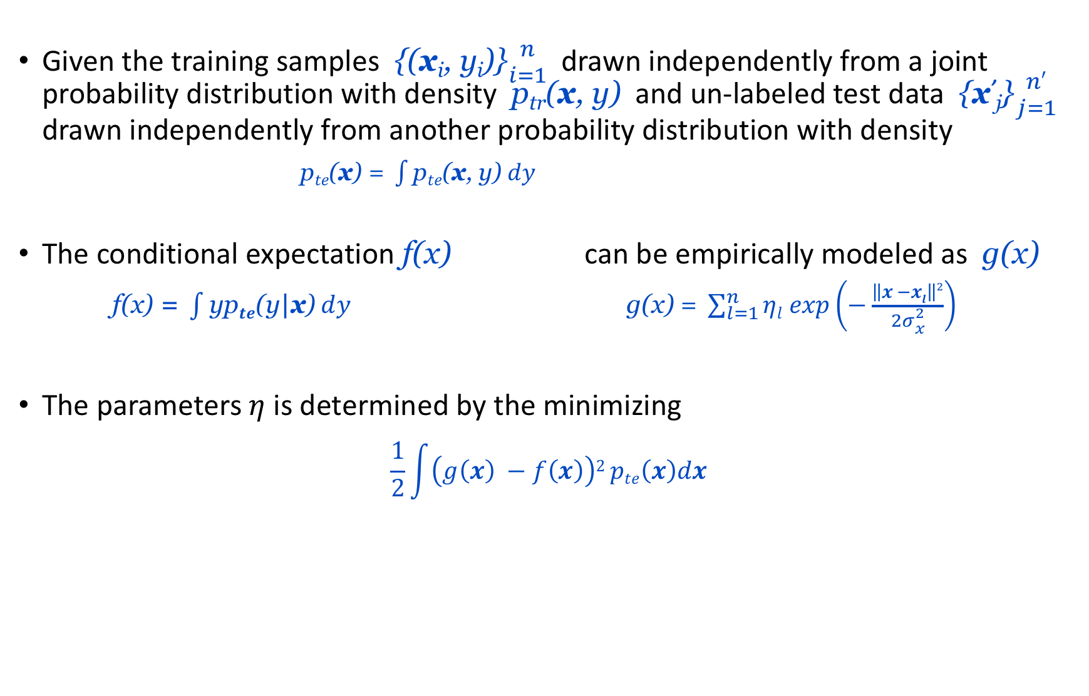
Importance Weighted Regression
Given the training samples {(x_{i}, y_{i})}${n \atop i=1}$ drawn independently from a joint probability distribution with density p_{tr}(x, y) and un-labeled test data {x’_{j}}${n′ \atop j=1}$ drawn independently from another probability distribution with density
$\text{p}te\text{(}\text{x}\text{) = }\int{\text{p}te\text{(}\text{x}\text{, }\text{y}\text{)} dy}$
The conditional expectation f(x) can be empirically modeled as g(x)
$\text{f}\text{(}\text{x}\text{)}\text{ = }\int{\text{yp}te\text{(}\text{y}\text{|}\text{x}\text{)} dy}$ $\text{g}\text{(}\text{x}\text{) = }\sum_{l=1}^{n}{ηl exp\left(−\frac{\left\|x −xl\right\|2}{2σ{2 \atop x}}\right)}$
The parameters $η$ is determined by the minimizing $\frac{1}{2}\int{\left(g\left(x\right) −f\left(x\right)\right)2}pte\left(x\right)dx$

Slide 10
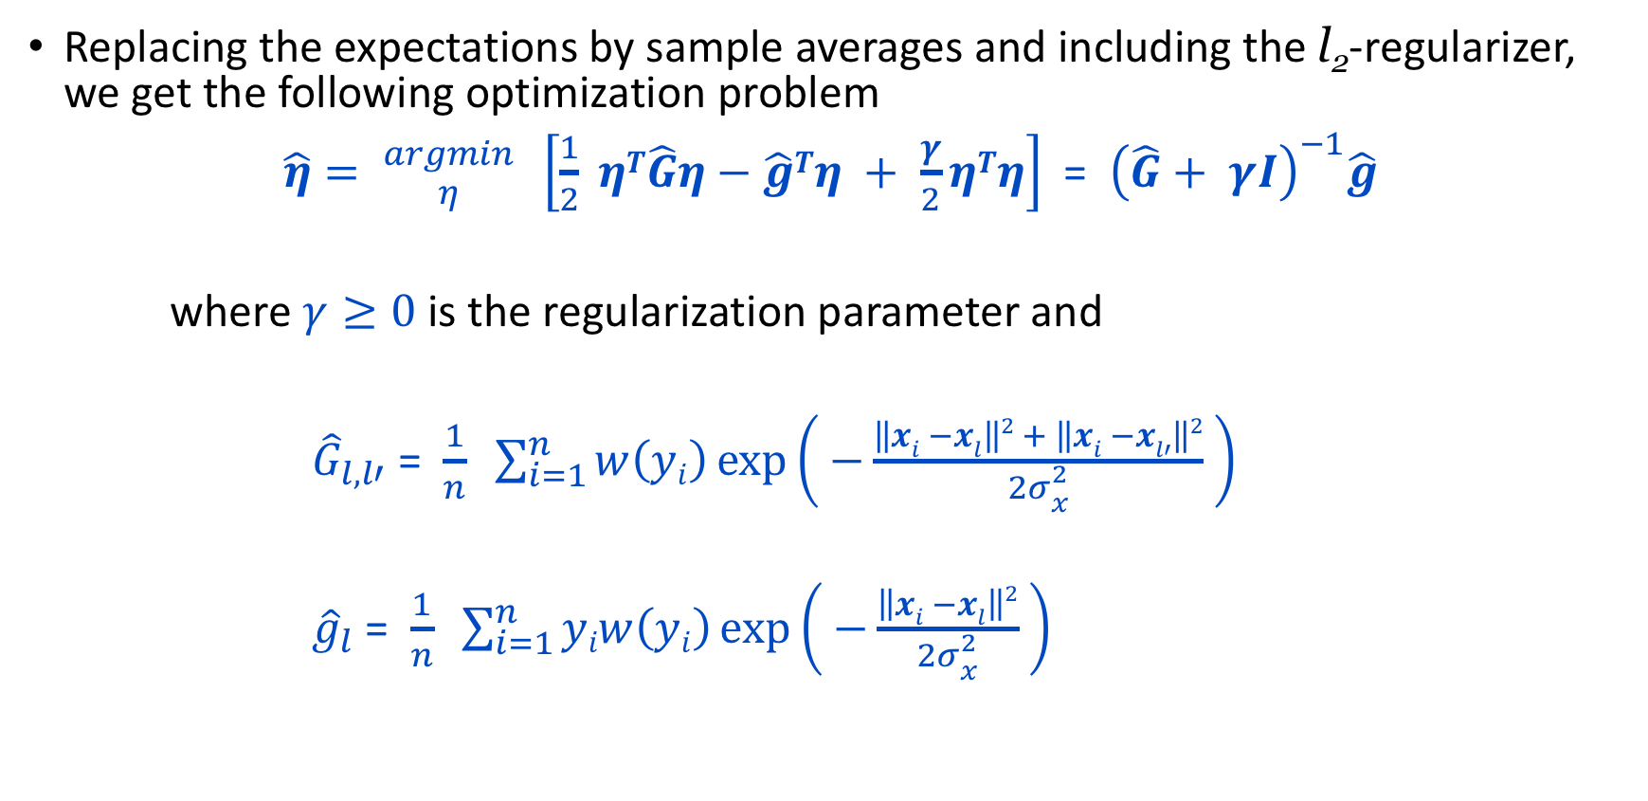
Importance Weighted Regression (contd..)
Replacing the expectations by sample averages and including the l₂-regularizer, we get the following optimization problem
$\hat{η}= {argmin \atop η} \left[\frac{1}{2} ηT\hat{G}η−\hat{g}Tη + \frac{γ}{2}ηTη\right]$ = ${\left(\hat{G}+ γI\right)}^{−1}\hat{g}$
where $γ≥0$ is the regularization parameter and
${\hat{G}}_{l,l′}$ = $\frac{1}{n} \sum_{i=1}^{n}{w\left(yi\right)\exp\left( −\frac{\left\|xi −xl\right\|2 + \left\|xi −xl′\right\|2}{2σ{2 \atop x}} \right)}$
${\hat{g}}_{l}$ = $\frac{1}{n} \sum_{i=1}^{n}{yiw\left(yi\right)\exp\left( −\frac{\left\|xi −xl\right\|2}{2σ{2 \atop x}} \right)}$

Slide 11
Problem
Formulation …

Slide 12
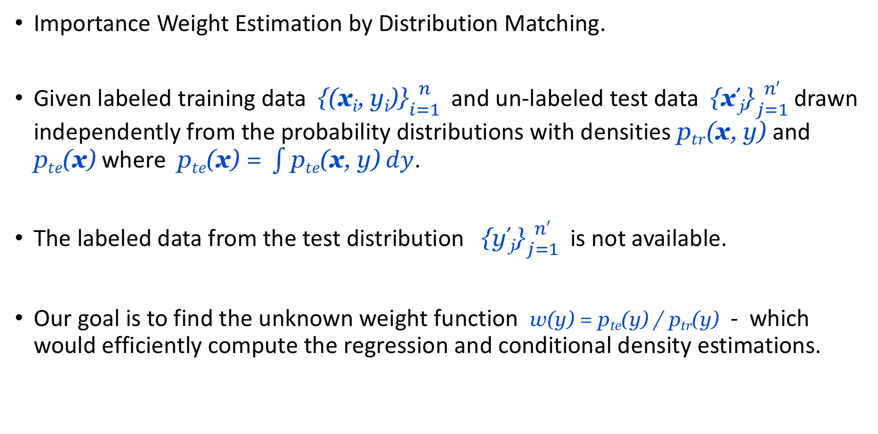
w(y) Problem Formulation (L2IWE) . . .
Importance Weight Estimation by Distribution Matching.
Given labeled training data {(x_{i}, y_{i})}${n \atop i=1}$ and un-labeled test data {x’_{j}}${n′ \atop j=1}$drawn independently from the probability distributions with densities p$tr$(x, y) and $\text{p}te\text{(}\text{x}\text{)}$ where $\text{p}te\text{(}\text{x}\text{)}\text{ = }\int{\text{p}te\text{(}\text{x}\text{, }\text{y}\text{)} dy}$.
The labeled data from the test distribution {y’_{j}}${n′ \atop j=1}$ is not available.
Our goal is to find the unknown weight function w(y) = p_{te}(y) / p_{tr}(y) - which would efficiently compute the regression and conditional density estimations.

Slide 13
Solution …

Slide 14
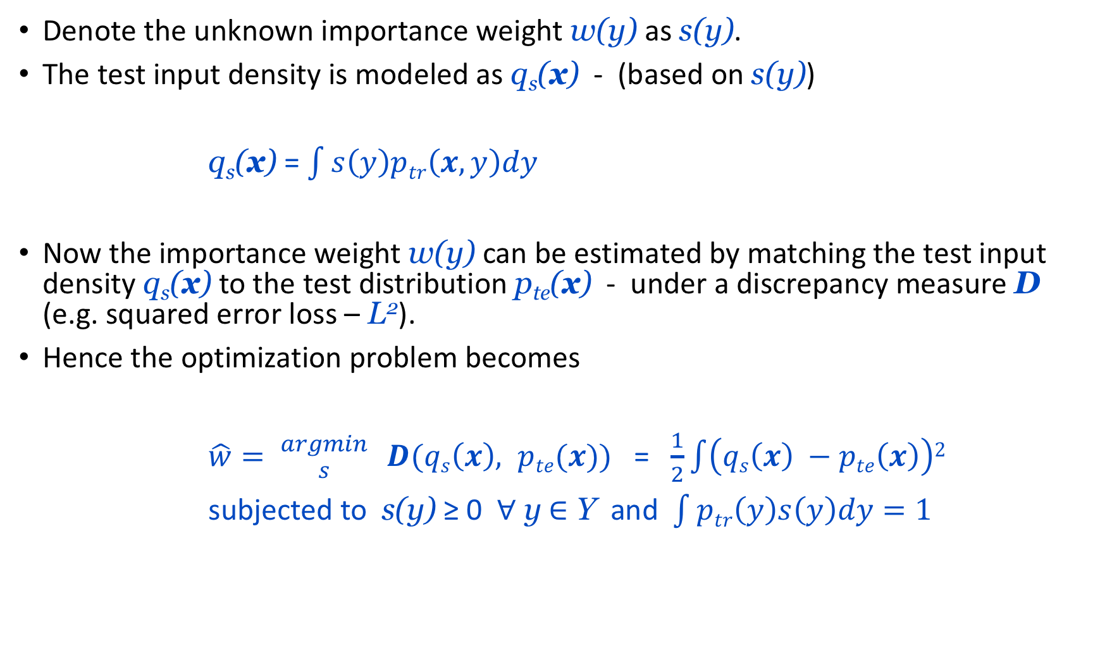
Solution
Denote the unknown importance weight w(y) as s(y).
The test input density is modeled as q_{s}(x) - (based on s(y))
q_{s}(x) = $\int{s\left(y\right)ptr\left(x,y\right)dy}$
Now the importance weight w(y) can be estimated by matching the test input density q_{s}(x) to the test distribution p_{te}(x) - under a discrepancy measure D (e.g. squared error loss – L²).
Hence the optimization problem becomes
$\hat{w}= {argmin \atop s} D(qs\left(x\right), pte(x))$ = $\frac{1}{2}\int{\left(qs\left(x\right) −pte\left(x\right)\right)2}$
subjected to s(y) ≥ 0 $∀$ y $∈$ Y and $\int{ptr\left(y\right)s\left(y\right)dy=1}$

Slide 15
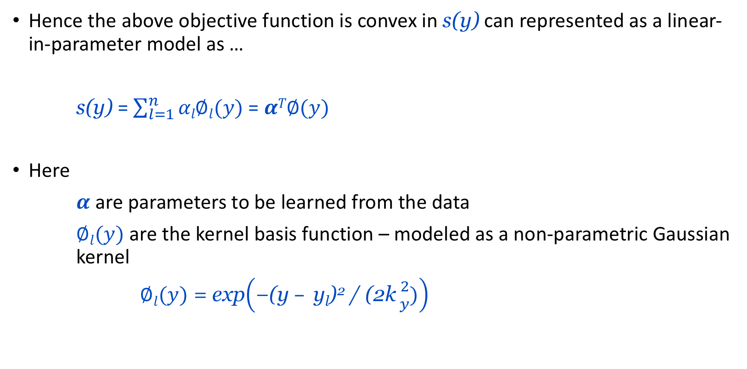
Solution (contd..)
Hence the above objective function is convex in s(y) can represented as a linear-in-parameter model as …
s(y) = $\sum_{l=1}^{n}{αl∅l(y)}$ = $αT∅(y)$
Here
$α$ are parameters to be learned from the data
$∅l(y)$ are the kernel basis function – modeled as a non-parametric Gaussian kernel
$∅l(y)$ = exp$\left(\text{−(}\text{y} – \text{yl}\text{)}\text{2}\text{ / (2}\text{k}{2 \atop y})\right)$

Slide 16
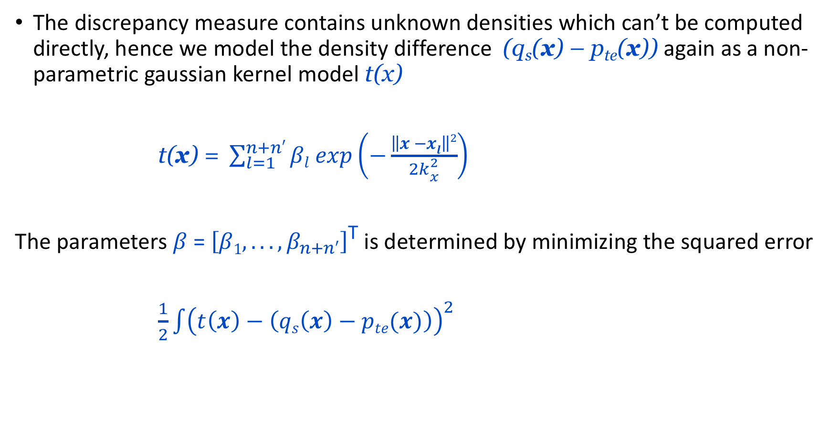
Solution (contd..)
The discrepancy measure contains unknown densities which can’t be computed directly, hence we model the density difference (q_{s}(x) – p_{te}(x)) again as a non-parametric gaussian kernel model t(x)
$\text{t}\text{(}\text{x}\text{) = }\sum_{l=1}^{n+n′}{βl exp\left(−\frac{\left\|x −xl\right\|2}{2k{2 \atop x}}\right)}$
The parameters $β$ = $\left[β1, . . . , β_{n+n′}\right]$^{T} is determined by minimizing the squared error
$\frac{1}{2}\int{{\left(t\left(x\right)−\left(qs\left(x\right)−pte(x)\right)\right)}^{2}}$

Slide 17
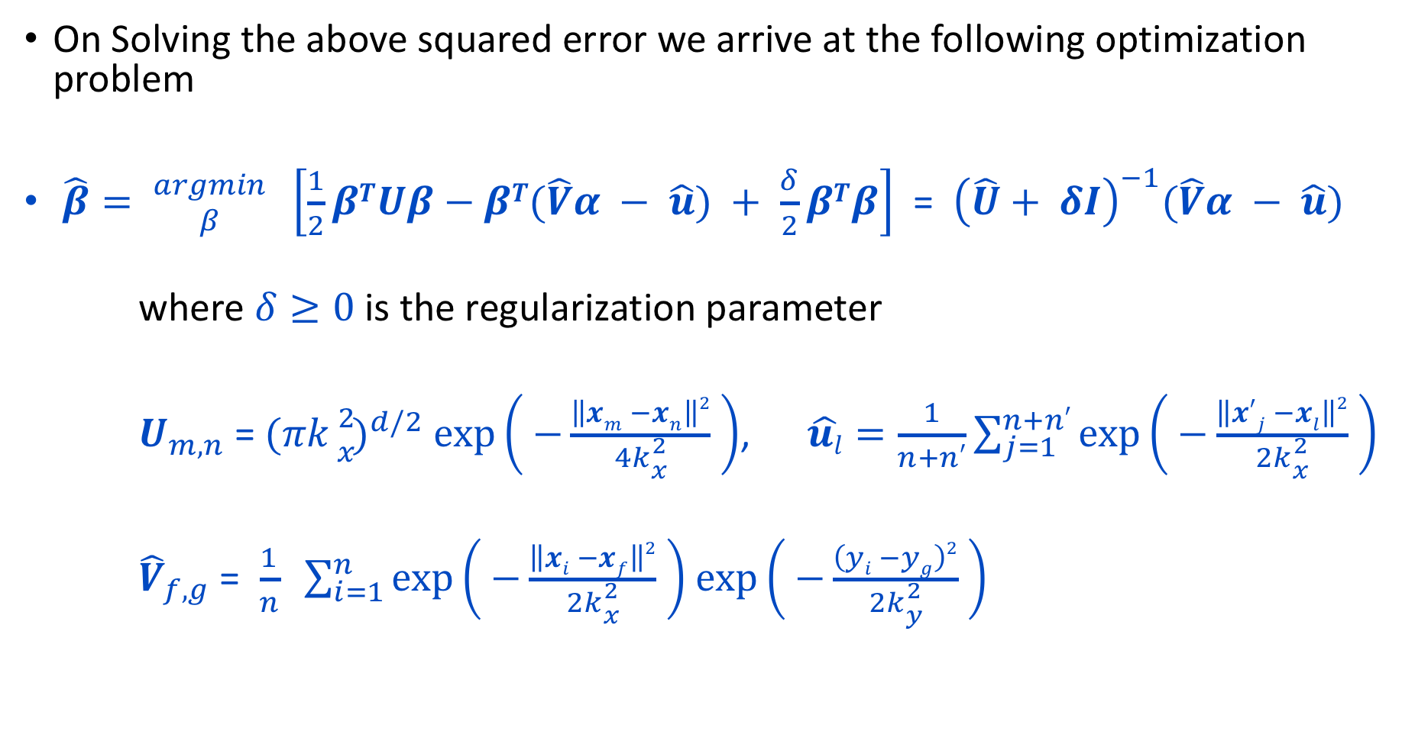
Solution (contd…)
On Solving the above squared error we arrive at the following optimization problem
$\hat{β}= {argmin \atop β} \left[\frac{1}{2}βTUβ−βT(\hat{V}α − \hat{u}) + \frac{δ}{2}βTβ\right]$ = ${\left(\hat{U}+ δI\right)}^{−1}(\hat{V}α − \hat{u})$
where $δ≥0$ is the regularization parameter
$U_{m,n}$ = ${(πk{2 \atop x})}^{d/2}$ $\exp\left( −\frac{\left\|xm −xn\right\|2}{4k{2 \atop x}} \right)$, $\hat{ul}=\frac{1}{n+n′}\sum_{j=1}^{n+n′}{\exp\left( −\frac{\left\|x′j −xl\right\|2}{2k{2 \atop x}} \right)}$
${\hat{V}}_{f,g}$ = $\frac{1}{n} \sum_{i=1}^{n}{\exp\left( −\frac{\left\|xi −xf\right\|2}{2k{2 \atop x}} \right)}$ $\exp\left( −\frac{\left(yi −yg\right)2}{2k{2 \atop y}} \right)$

Slide 18
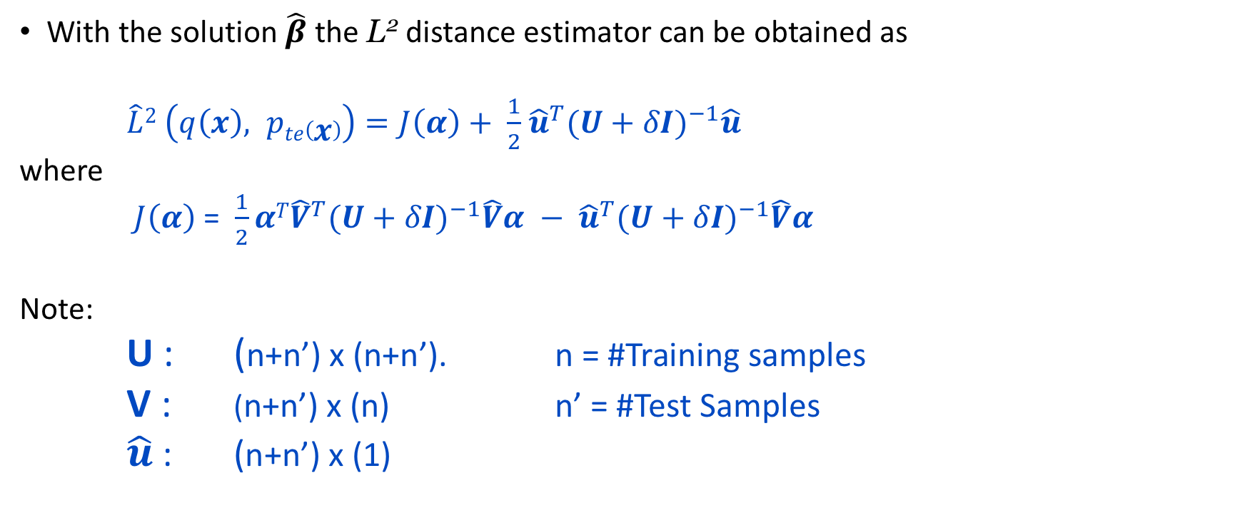
Solution (contd…)
With the solution $\hat{β}$ the L² distance estimator can be obtained as
$\hat{L}2 \left(q\left(x\right), pte\left(x\right)\right)=J\left(α\right)+ \frac{1}{2}$ ${\hat{u}}^{T}{(U+δI)}^{−1}\hat{u}$
where
$J\left(α\right)$ = $\frac{1}{2}αT{\hat{V}}^{T}{(U+δI)}^{−1}\hat{V}α − {\hat{u}}^{T}{(U+δI)}^{−1}\hat{V}α$
Note:
U : (n+n’) x (n+n’). n = #Training samples
V : (n+n’) x (n) n’ = #Test Samples
$\hat{u}$ : (n+n’) x (1)

Slide 19
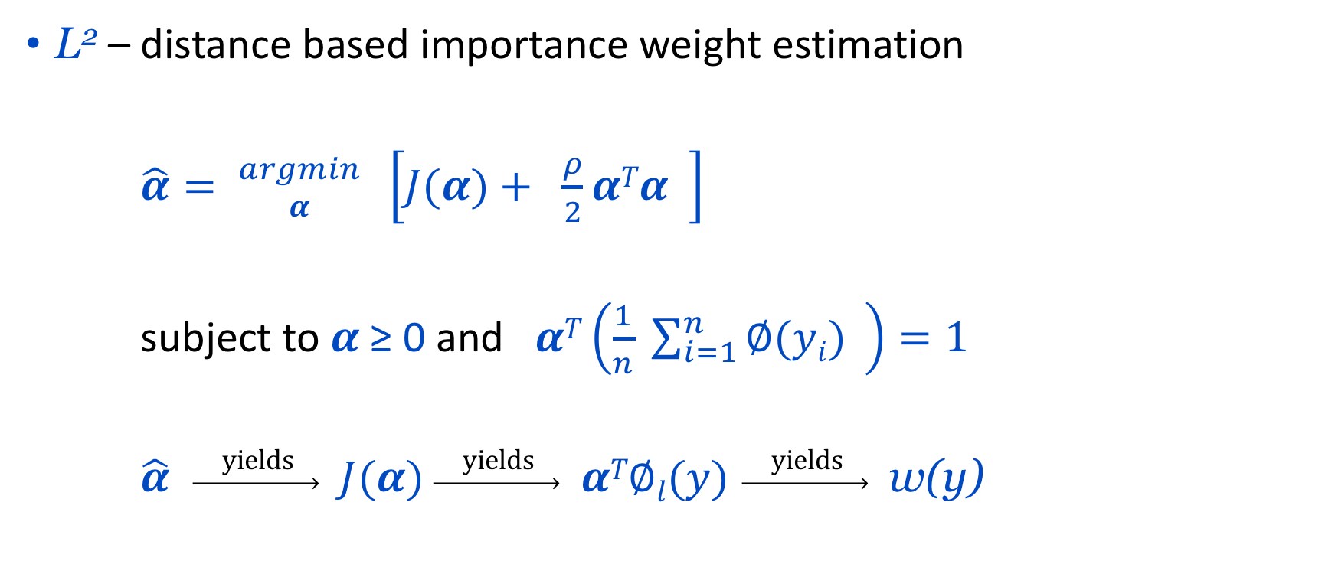
Solution (contd…)
L² – distance based importance weight estimation
$\hat{α}= {argmin \atop α} \left[J(α)+ \frac{ρ}{2}αTα \right]$
subject to $α$ ≥ 0 and $αT\left(\frac{1}{n} \sum_{i=1}^{n}{∅(yi)} \right)=1$
$\hat{α}$ $\underset{→}{ \text{yields} }$ $J(α)$ $\underset{→}{ \text{yields} }$ $αT∅l(y)$ $\underset{→}{ \text{yields} }$ w(y)

Slide 20
Plots …

Slide 21
Importance Weights …

Slide 22
Importance Weights - Regression

Slide 23
Importance Weights - CDE

Slide 24
Questions ?

Slide 25
Thank You !!!

